Slide 1
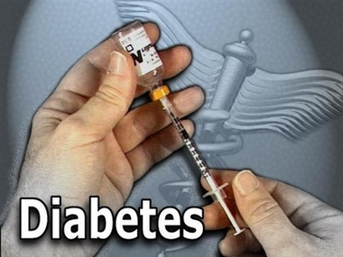

Slide 2
What is Diabetes?
Diabetes is a chronic disease that occurs either when the pancreas does not produce enough insulin or when the body cannot effectively use the insulin it produces.
Insulin is a hormone that regulates blood sugar. Hyperglycaemia, or raised blood sugar, is a common effect of uncontrolled diabetes and over time leads to serious damage to many of the body's systems, especially the nerves and blood vessels.

Slide 3
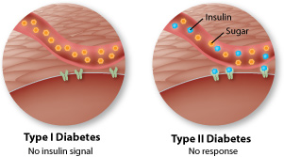
Type 1 & 2 Diabetes
It is known as insulin- dependent and is caused by deficient insulin production and requires daily injection of insulin
Type 2 is formerly called non-insulin-dependent, results from the body’s ineffective use of insulin and is largely the result of excess body weight and physical inactivity

Slide 4
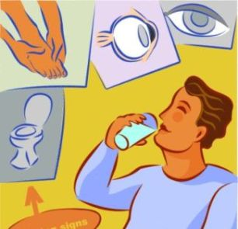
Key facts
346 million people worldwide have diabetes.
In 2004, an estimated 3.4 million people died from consequences of high blood sugar.
More than 80% of diabetes deaths occur in low- and middle-income countries.
WHO projects that diabetes deaths will double between 2005 and 2030.
Healthy diet, regular physical activity, maintaining a normal body weight and avoiding tobacco use can prevent or delay the onset of type 2 diabetes.

Slide 5
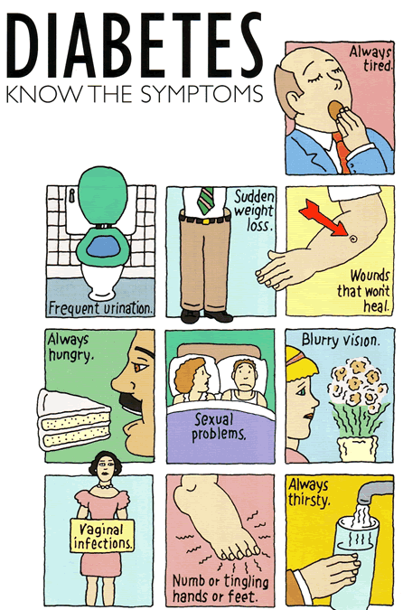
Consequences Of Diabetes
Over time, diabetes can damage the heart, blood vessels, eyes, kidneys, and nerves.
Diabetes increases the risk of heart disease and stroke. 50% of people with diabetes die of cardiovascular disease
Combined with reduced blood flow, it increases the chance of foot ulcers
Diabetes is among the leading causes of kidney failure. 10-20% of people with diabetes die of kidney failure.
Diabetes results to damage to the nerves, and affects up to 50% of people with diabetes

Slide 6
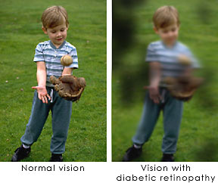
Diabetic retinopathy (inflammation) causes blindness. After 15 years of diabetes, approximately 2% of people become blind, and about 10% develop severe visual impairment.

Slide 7
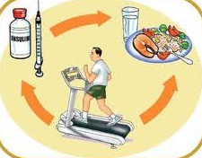
Prevention
To prevent diabetes, simple lifestyle measures have been adapted that people should know:
Achieve and maintain healthy body weight;
Be physically active – at least 30 minutes of regular, moderate-intensity activity on most days;
Eat a healthy diet of between three and five servings of fruit and vegetables a day and reduce sugar and saturated fats intake;
Avoid tobacco use – smoking increases the risk of cardiovascular diseases.

Slide 8
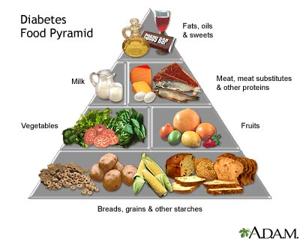

Slide 9
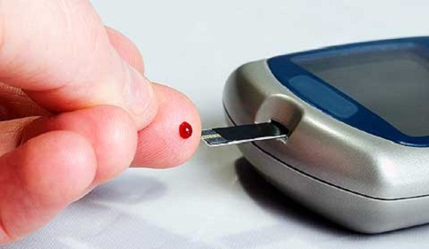
WHO activities to prevent and control diabetes…
WHO aims to support the adoption of effective measures for the prevention and control of diabetes, particularly in low and middle-income countries. To end diabetes, WHO:
Provides scientific guidelines for diabetes prevention;
Develops norms and standards for diabetes care;
Builds awareness on the global epidemic of diabetes
It also Conducts surveillance of diabetes and its risk factors.
The WHO Global strategy on diet, physical activity and health focuses to promote healthy diet and regular physical activity, thereby reducing the growing global problem of overweight and obesity caused by diabetes
World Diabetes Day is celebrated on 14 November by WHO

Slide 10
Data from the 2011 National Diabetes Fact Sheet (released Jan. 26, 2011)
Total prevalence of diabetes
Total: 25.8 million children and adults in the United States—8.3% of the population—have diabetes.
Diagnosed: 18.8 million people
Undiagnosed: 7.0 million people
New Cases: 1.9 million new cases of diabetes are diagnosed in people aged 20 years and older in 2010.
Under 20 years of age
215,000, or 0.26% of all people in this age group have diabetes
About 1 in every 400 children and adolescents has diabetes
Age 20 years or older
25.6 million, or 11.3% of all people in this age group have diabetes
Age 65 years or older
10.9 million, or 26.9% of all people in this age group have diabetes
Men
13.0 million, or 11.8% of all men aged 20 years or older have diabetes
Women
12.6 million, or 10.8% of all women aged 20 years or older have diabetes

Slide 11
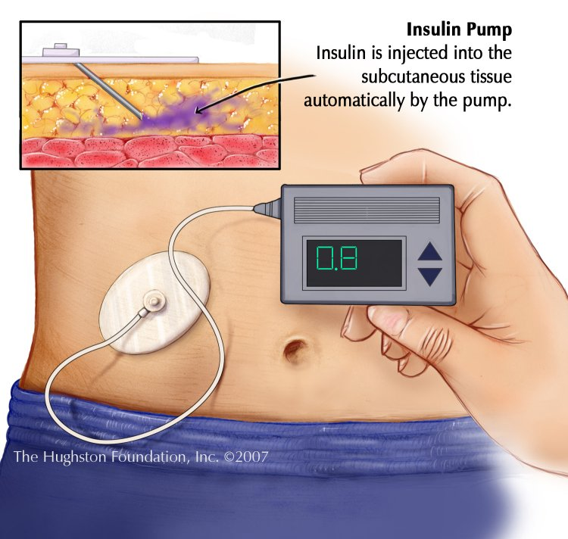
Diagnosis and treatment
Blood testing
Treatment of diabetes involves lowering blood glucose and the levels of other known risk factors that damage blood vessels
Treatment that are both cost saving and feasible in developing countries include:
Moderate blood glucose control. People with type 1 diabetes require insulin;
People with type 2 diabetes can be treated with oral medication, but may also require insulin;
Blood pressure control;
Foot care.

Slide 12
Diabetes in India
Over 30 million have now been diagnosed with diabetes in India.
In urban areas of India, the rate is thought to be 9 per cent.
In rural areas, the prevalence is approximately 3 per cent of the total population.
The estimate of the actual number of diabetics in India is around 40 million.
This means that India actually has the highest number of diabetics of any one country in the entire world.
In India, the type of diabetes differs considerably from that in the Western world: Type 1 is considerably more rare, and only about 1/3 of type II diabetics are overweight or obese.
Diabetes is also beginning to appear much earlier in life in India, meaning that chronic long-term complications are becoming more common. The implications for the Indian healthcare system are enormous.

Slide 13
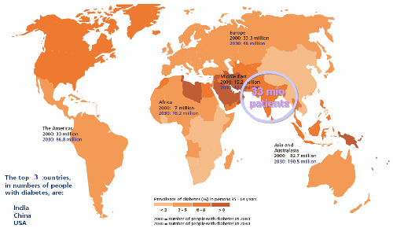
Diabetes in India

Slide 14
Bibliography
http://www.emedicinehealth.com/diabetes/article_em.htm
http://www.diabetes.org/
http://www.who.int/mediacentre/factsheets/fs312/en/

Slide 16
Presentation By:
Vatsal, Jheel, Mahek & Jay..

