Slide 1
about…. Education in Lithuania

Slide 2
Literacy rate in Lithuania
9
9.7
%
A LEDC country stands on 8th rank of World Literacy rate of countries…

Slide 3
About Lithuania
1
The Republic of Lithuania is a European country on the eastern coast of the Baltic Sea. Lithuania borders on the Russian federation, the Republic of Belarus, the Republic of Latvia and the Republic of Poland
Area: 65 300 square km.
Capital: Vilnius.
Population: 3 440 000; 83.5% are
Lithuanians; 6.7% Poles, 6.3%
Russians,1.2% Belarusians,
2.3% others.

Slide 4
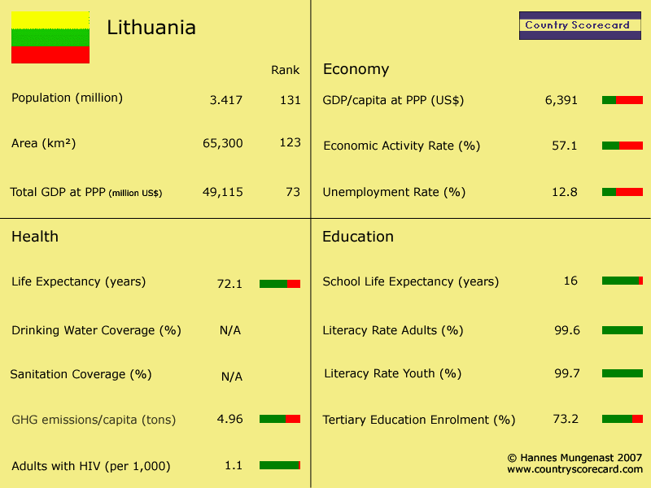

Slide 5
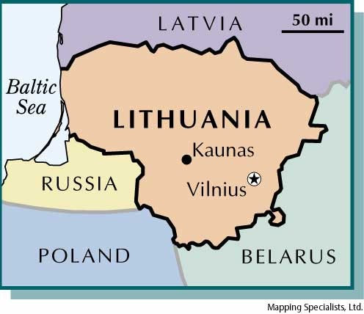

Slide 6
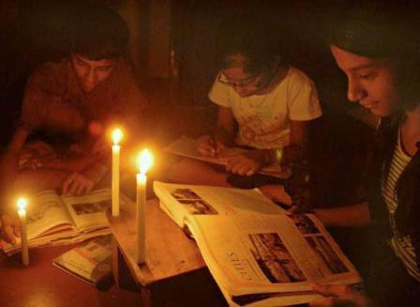
WHY HIGH LITERACY RATE ?
People prefer sending their children to school and getting educated
Parents are aware to the benefits of educations, and getting educated themselves too
Education in Lithuania is free of charge and compulsory from the age of 6 or 7 to 16 years, as stated in the national Law on Education.
In 1996, the gross primary enrollment rate was 98 percent. Primary school attendance rates were unavailable for Lithuania as of 2001. While enrollments rates indicate a level of commitment to education, they do not always reflect children’s participation in school.
In Lithuania everybody has a right to education.
Secondary education is compulsory until 16 years of age. Children start school when they are 6 or 7 years of age.

Slide 7
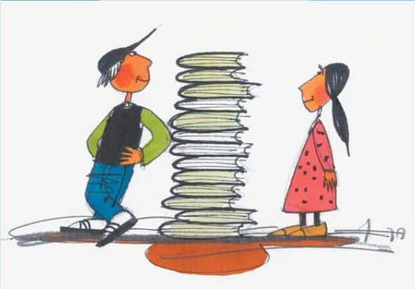
All children have equal opportunities to prepare for school.
All children have a socially just learning environment.
At least 95% of children receive quality basic education.
All children with special needs have an opportunity to learn in a friendly environment.
At least 60% of youngsters receive quality higher education.
At least 85% of Lithuanian population of employable age have a real opportunity and ability to use information and communication technologies (ICT).
MAJOR OBJECTIVES FOR EDUCATION
IN LITHUANIA BY 2015

Slide 8
What is Government doing for it?
Executing Educational schemes for disabled people, and good scholarships to students
In the year 2000 the total number of schools built were 2,031. There is a project still going on
Public Schools are getting more popular and promoted by government
Public schools have up to date information with good resources and uniforms

Slide 9
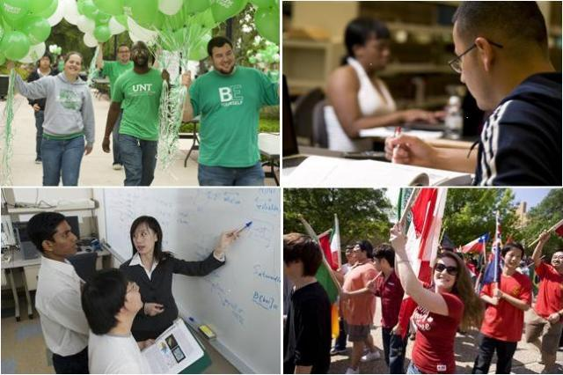
Awareness Programs
The Community Multicultural Awareness Program (CMAP) has been created.
The purpose of this multicultural education is to promote more Lithuanians by educating young adults on enrolling children for education
Themes
Intercultural Dialogue
Diversity
Multiculturalism
Tolerance Education
World View Discussions

Slide 10
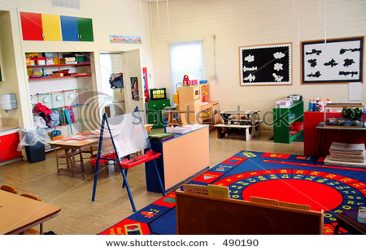
Education Structure

Slide 11
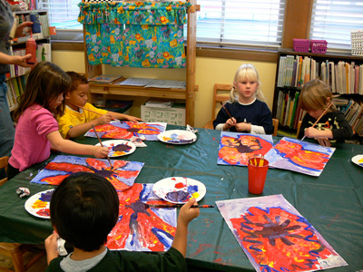
Pre-school Education
Children of pre-school age are educated in nurseries (up to 3 years) and kindergartens (up to 6-7 years)
Orphans and homeless children are educated in children's homes.

Slide 12
General Education
General education is provided by the following educational institutions: primary schools of general education (four years);
Primary school type kindergartens;
Basic schools of general education (nine years);
Secondary schools of general education (twelve years);
Gymnasiums (four years);
Special schools; youth schools where pupils can receive basic education; vocational schools (providing basic or secondary education alongside vocational training);
Schools of general education for adults (education centers)

Slide 13
Higher Education
Young people can obtain higher education in 15 higher schools of Lithuania. Higher schools enroll people with secondary education. The course of studies in higher schools lasts 4 or 6 years.
Institutions of higher education admit people with secondary education acquired in secondary schools of general education, in gymnasiums, vocational school of further education or adult education institutions.
Higher education is recognized upon completion of the basic studies at the institution of higher education. Thereafter, specialized professional studies, a course for a Master's degree and doctoral studies may be pursued.
Upon completion of the basic studies, a Bachelor's degree, an equivalent academic qualification degree. Upon completion of the basic studies, specialized professional studies for a Master's degree may be pursued.

Slide 14
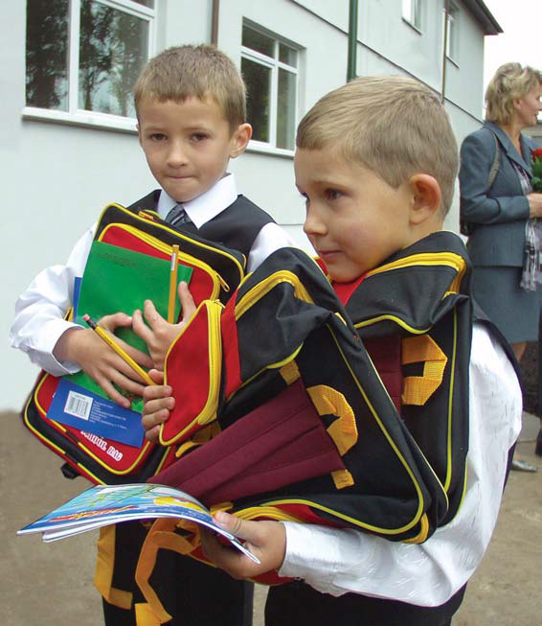
FINANCING
Education is financed in the form of allocations from the State budget and municipal budgets as well as other financial means.
Programs of formal education offered at State- funded, municipal and non-State funded schools, except for higher education institutions, and programmes of non-formal education of children are financed out of the State and municipal budgets.

Slide 15
Lithuania Literacy Statistics

Slide 16
Lithuania Literacy Statistics

Slide 17
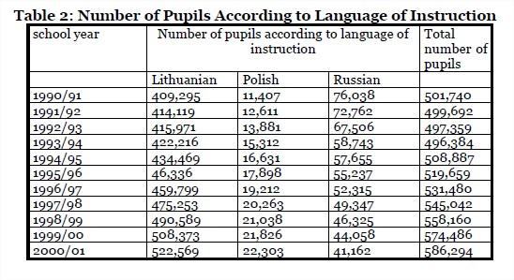
Language and Learning…

Slide 18
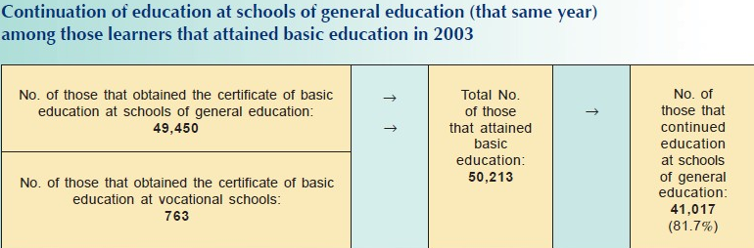
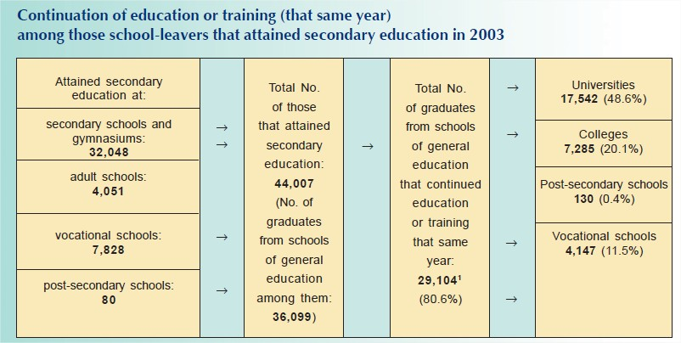

Slide 20
MADE BY :

Slide 21
Vatsal Sagparia

