Slide 2
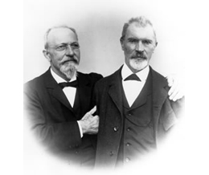
Bausch & Lomb
Bausch & Lomb, an American company based in Rochester, New York, is one of the world's leading suppliers of eye health products, such as contact lenses and lens care products today.
Bausch & Lomb was founded in 1853 by two German immigrants, John Jacob Bausch and Henry C. Lomb in Rochester, New York.
Bausch a trained optician found his friend, Lomb the financier and partner he needed for a small but ambitious workshop producing monocles
In 1861, the company manufactured Vulcanite rubber eyeglass frames and other precision vision products

Slide 3
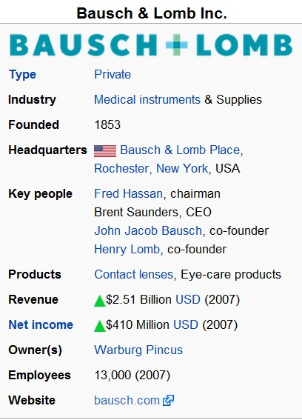

Slide 4
Starting of Ray Ban..
The further development of the firm was affected by political events.
Because of the World Wars and the consequent need for optical instruments such as field glasses, target finders, camera lenses, binocular telescopes, searchlight mirrors, torpedo tube sights and periscopes, the product range could be considerably broadened.
During this period, military products represented 70% of total production. One of the best-known developments in this period was the world-famous Ray-Ban brand sunglasses, developed for pilots in 1936.

Slide 5
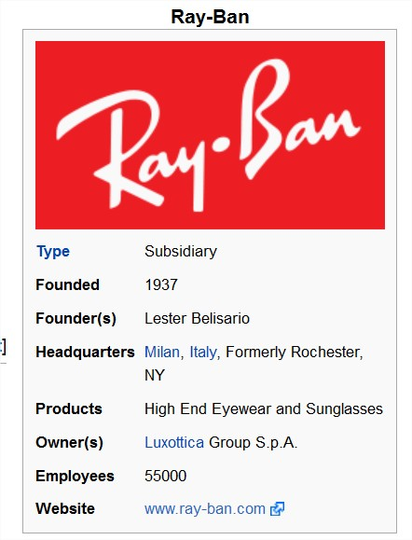
Notes:
Subsidiary – a company completely controlled by other company
Luxottica- is one of the world’s highest eyewear producing company, which is a joint stock company with ray-ban

Slide 6
Ray-Ban is an American high end manufacturer of sunglasses, founded in 1937 by Bausch & Lomb
They were introduced for the United States Army Air Corps. In 1999, Bausch & Lomb sold the brand to the Italian Luxottica Group for a reported $640 million.

Slide 7
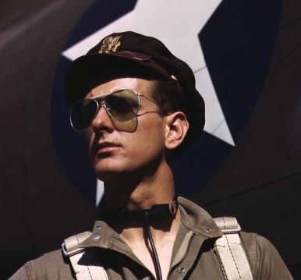
Big Idea...
Ray-Bans were first created in 1936.
The idea of Ray Bans began some years earlier when Lieutenant John A. Macready returned from a balloon flying adventure and complained that the sun had permanently damaged his eyes.
He contacted Bausch & Lomb asking them to create sunglasses that would provide protection and also look elegant.
They had the task of creating a lightweight pair of sunglasses that matched the contours of the wearer’s eye sockets, while allowing minimal light to enter during prolonged flight.
On May 7, 1937, Bausch & Lomb took out the copyright.

Slide 8
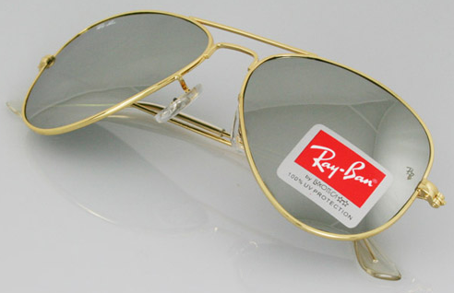
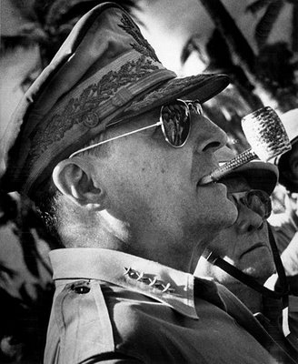
The prototype, known as Anti-Glare, had an extremely light frame weighing 150 grams.
They were made of gold-plated metal with green lenses made of mineral glass to filter out infrared and ultraviolet rays.
Pilots in the United States Army Air Corps immediately adopted the sunglasses. The army had intentions to have sunglasses that would protect the soldiers from the rays of the sun but yet still have an elegant look.
The Ray-Ban Aviator became a well-known style of sunglasses when General Douglas MacArthur landed on the beach in the Philippines in World War II, and photographers snapped several pictures of him wearing them. Ray Bans were quickly seen outside of just the army.

Slide 9
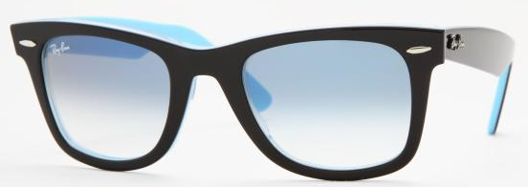
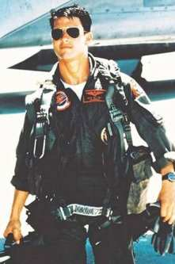
Growth…
Ray Bans quickly gained popularity through other wars and even made a entrance in the movies.
In 1952, Ray Ban created another style, the Ray Ban Wayfarer. The differences with these sunglasses were the plastic frames.
This design of the Wayfarer glasses became very popular with the public. The Wayfarer sunglasses were seen on movie stars, TV stars, and musicians.
Ray Ban still remains a top designer in the sunglasses industry with their constant change in colour, frames, and lenses.

Slide 10
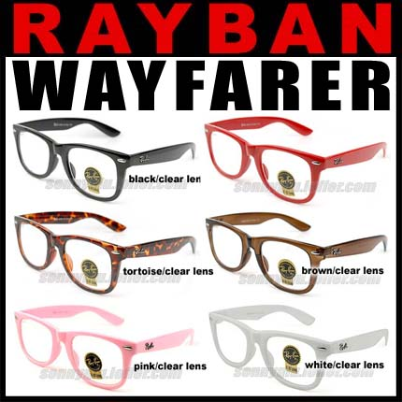
After Ray-Ban was sold to Luxottica group it still used the BL lenses
The company was renamed from
“B&L RAY-BAN U.S.A” to “B&L RAY-BAN ITALY”

Slide 11
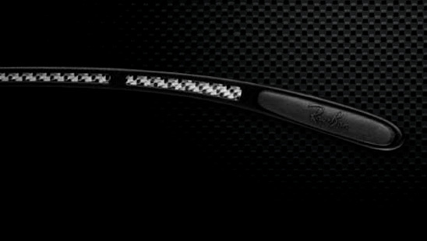
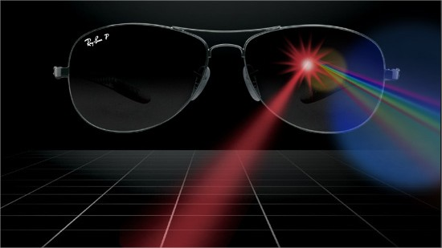
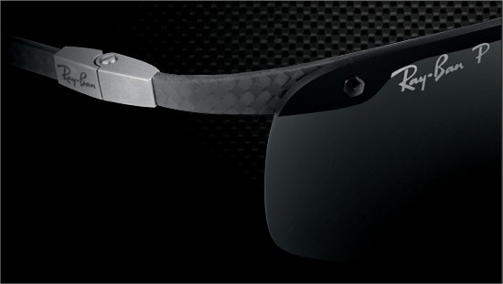

Slide 12
Bibliography..
For more information visit this website below:
www.ray-ban.com/india

Slide 14
Made by:
Vatsal Sagparia

