Slide 1
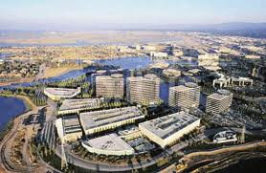
Silicon Valley of India - Bengaluru
Presentation By : Vatsal

Slide 2
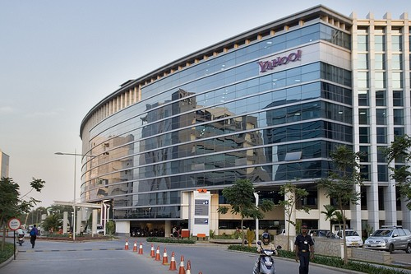
Introduction
The Silicon Valley of India is a nickname of the Indian city of Bangalore. As Bangalore is on the Mysore Plateau, the area is also sometimes referred to as "Silicon Plateau"
The name signifies Bangalore's status as a hub for information technology (IT) companies in India and is a comparative reference to the original Silicon Valley, based around Santa Clara Valley, California, a major hub for IT companies in the United States
One of the earliest mentions of this nickname occurred in late 1980s in the Indian Express. The more prevalent application of the nickname Bangalore began in the 1990s based on a concentration of firms specialising in Research and Development (R&D), electronics and software production.

Slide 3
The History behind India’s Silicon Valley…
The Electronics City was the innovation of R. K. Baliga. He was the first Chairman and Managing Director of Karnataka State Electronics Development Corporation (in 1976 the government agency was created to expand the electronics industry in the state of Karnataka)
Baliga proposed the concept of developing the electronic city in the 1970s. The agency purchased 335 acres of land for its Electronics City project, which was meant to establish an industrial park in Bangalore
Notwithstanding complaints by the industrial park's residents on the condition of the roads, power and water availability, KEONICS (Karnataka State Electronics Development Corporation Limited) claimed initially that the title of Silicon Valley of India belonged to the city's Electronics City campus

Slide 4
Cont…
The publication also published interviews with IT industry professionals on the state of the IT industry in Bangalore and their perceptions of what lay ahead in the future saying to grow into a high technology hub, similar to Silicon Valley (approved by USAID).
Bangalore's IT industry grew during this period with the establishment of local and foreign IT companies. In 2001, Business Week published an article entitled "India's Silicon Valley" which traced the growth of the IT industry in India and particularly in Bangalore.
The use of the term "Silicon Valley of India" to refer to Bangalore grew in local media and as time progressed, in international media too.

Slide 5
Why Bengaluru?
India is the largest hub for English – Speaking IT professionals
Any Corporation or firm would find easy to hire any IT professional in Bengaluru so easy as it has a pool of IT professionals
R.K. Baliga was appointed to set the electric city and Government investment was available
Bengaluru has the best climatic conditions (pleasant atmosphere)

Slide 6
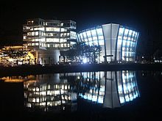
Technology & IT Industries
Bangalore is called the 'Silicon Valley of India' due to the large number of information technology companies located there. Many multinational corporations, especially computer hardware and software giants, have operations in Bangalore.
Bangalore's IT industry is divided into two main "clusters” - Electronics City and Whitefield. New clusters in Bellandur and Challaghatta have emerged in the last few years along the Outer and Inner Ring Roads.
Office of Oracle (formerly i-flex Solutions) at Bagmane Tech Park Bangalore

Slide 7
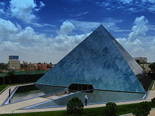
High – Tech Industries
Electronics City, located in the southern outskirts of Bangalore, is an industrial park spread over 330 acres (1.3 km²). Electronics City was formed in 1978
Some of the high tech firms headquartered in Electronic City are 3M, Hewlett Packard, Siemens, Infosys and Wipro
The Software Technology Parks of India, Bangalore (STPI) was started at Electronics City in 1991 by the Ministry of Information Technology.
The headquarters of Infosys, India's second largest IT company, is located in Bangalore

Slide 8
High – Tech Industries
Whitefield cluster is home to the International Tech Park Bangalore. It was created as a result of a joint venture between India and Singapore in January 1994
It is a large facility, comprising 8 buildings—Discoverer, Innovator, Creator, Explorer, Inventor, Navigator and Voyager. The ninth building which is under construction will be called "Avaitor“
The Export Promotion Industrial Park Zone (EPIP) in Whitefield provides campus facilities for SAP, iGATE, Dell, TCS, Unisys, Delphi, Huawei, Oracle, Perot Systems. Captive centres of Tesco, Shell, Aviva, GM, Schneider Electric, GE, Goodrich / UTC aerospace and Daimler Chrysler, Symphony Teleca Corp and Tangoe are also located in Whitefield.
And there are many other IT parks located in Ring Road, C.V. Raman Nagar of Bengaluru…

Slide 9
Economy
The Economy of Bangalore is an important part of the economy of India as a whole
The establishment and success of high technology firms in Bangalore has led to the growth of Information Technology (IT) in India. IT firms in Bangalore employ about 35% of India's pool of 10 lakh (1 million) IT professionals and account for the highest IT-related exports in the country
The city's income gross domestic product in 2004-05 was valued at INR 433.8 billion
One of the important factors stimulating Bangalore's growth was heavy central government investment in Bangalore's public sector industries. This led to the concentration of technical and scientific navigator in Bangalore, and is a factor in leading the "IT revolution" in Bangalore

Slide 10
The Increase in IT Companies ….
Bengaluru is known as the “Silicon Valley of India”, the number of IT and software companies located in the city are rapidly approaching the number of companies located in Northern California, the original Silicon Valley
It is growing so rapidly, that it is speculated to surpass the original. “ In the next 15-20 years, Silicon Valley of the US would be left behind by Bangalore”

Slide 11
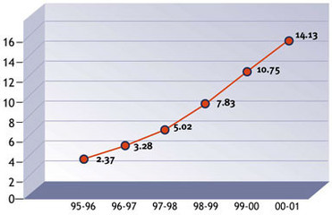
India as a Software exporter
Percentage (%)
Year
Software Export as a percentage of India’s Total Export

Slide 12
Thank You!

